Slide 1
course Esilv - Angular & Node Js Advanced Web Features
arnaud.nauwynck@gmail.com

Slide 2
Outline
Some Advanced features
AG-Grid
HighCharts
Generating (Angular) Client from Swagger
Code Scafolding
Security: Cookie, Login, OAuth2, JWT, ...
RxJs, Auto completion, ng-prime
Final Words

Slide 3
Reminder
5 x CMs - Lessons
5 x TDs - Hands on
1 Project submission .... deadline 31 dec

Slide 4
Reminder ... expectation on project submission for Exam
Your project MUST include at least 1 advanced feature

Slide 5
Outline
Some Advanced features
AG-Grid
HighCharts
Generating (Angular) Client from Swagger
Code Scafolding
Security: Cookie, Login, OAuth2, JWT, ...
RxJs, Auto completion, ng-prime
Final Words

Slide 6

https://www.ag-grid.com/

Slide 7
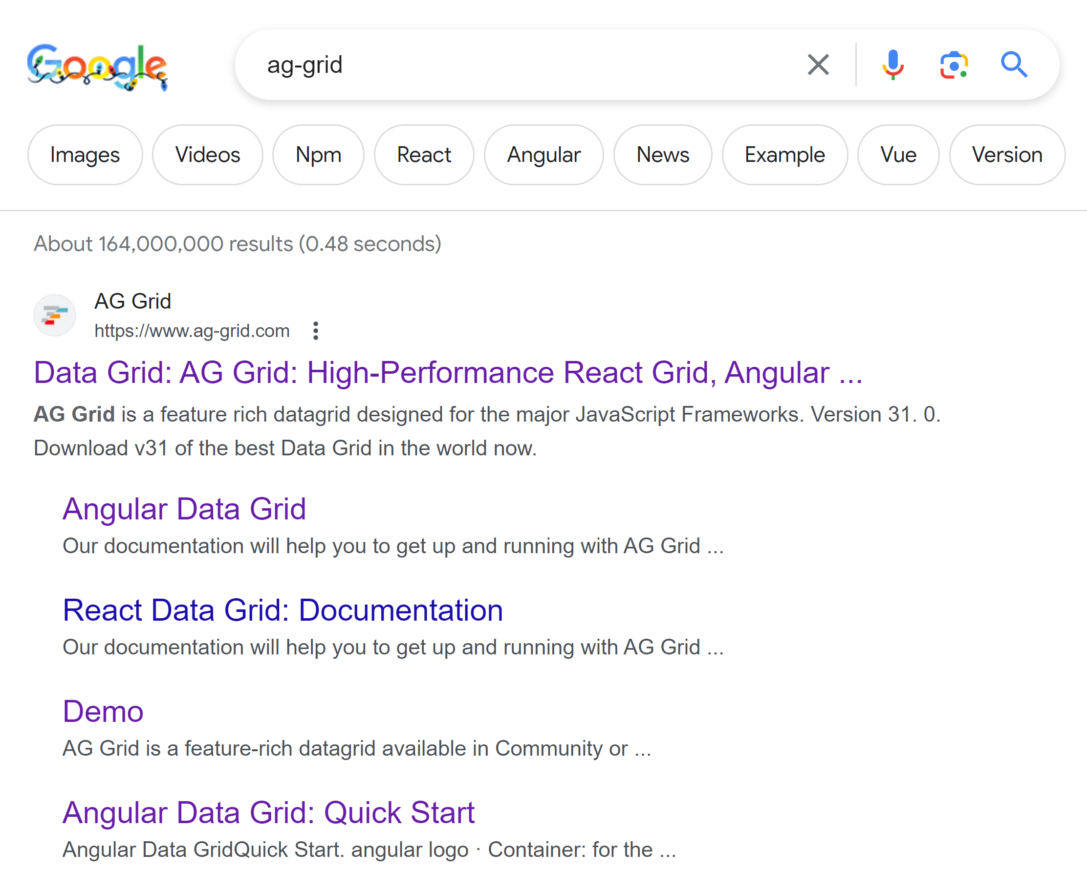
AG-Grid

Slide 8
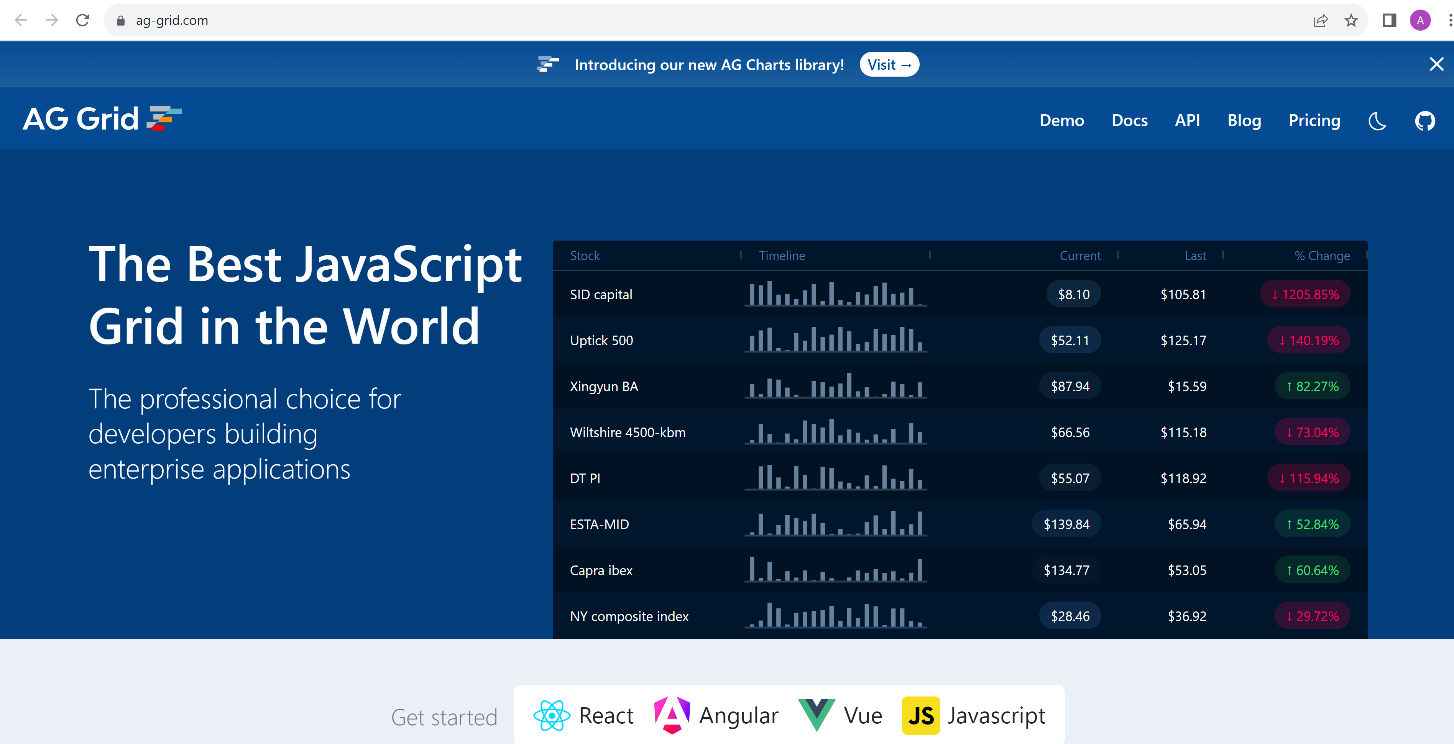
https://ag-grid.com

Slide 9
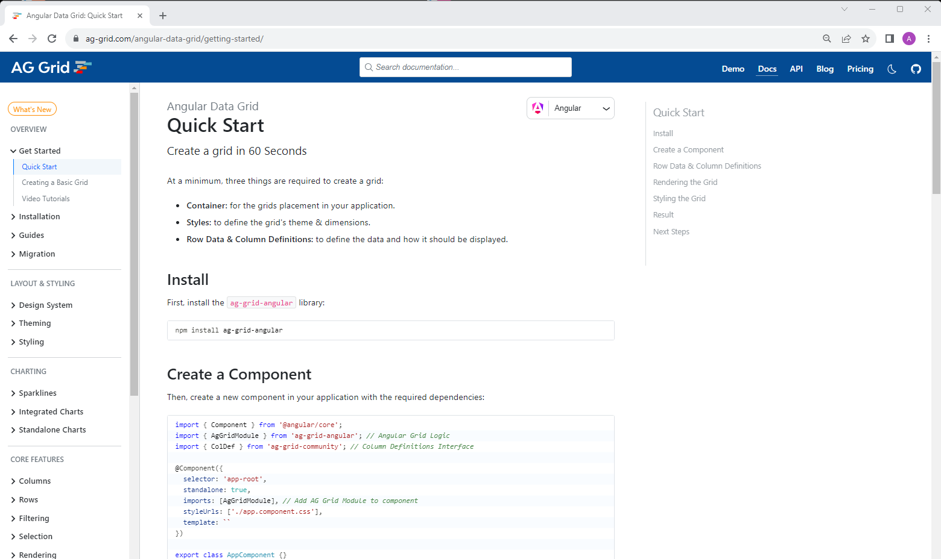
Getting Started

Slide 10
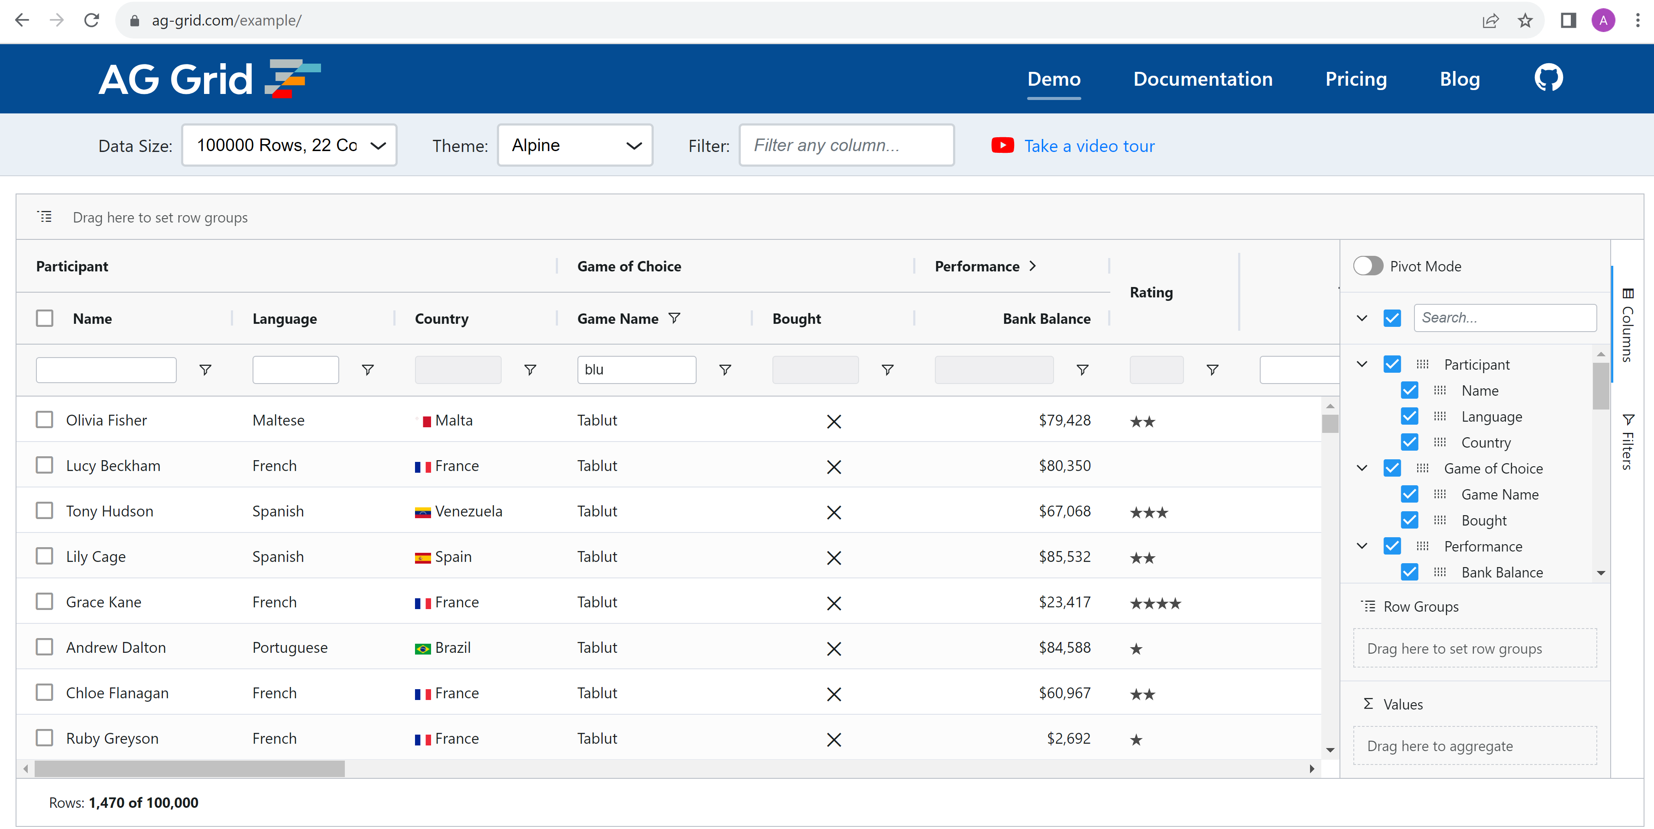
https://ag-grid.com/example

Slide 11
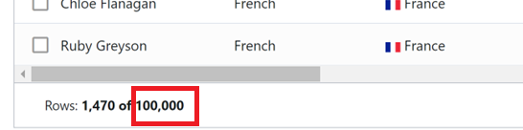
Did you notice? "Rows ... of 100,000"

Slide 12

AG-Grid performances
Naive
create millions of
<div></div>
<div></div> <div></div>
<div></div>
<div></div>
Use Browser to scroll page
Virtual Scrolling
create ~50 only if visible
<div ..translateY(0px)>
<div ..translateY(41px)>
<div ..translateY(82px)>
change "div.y" position
when scrolling Scroll

Slide 13




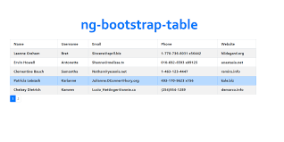
Your-own-table vs AG-Grid
<div *ngFor="let row of rows"> <div class="row">{{row}}</div>
</div>

Slide 14
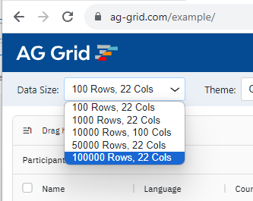
Try online yourself
Then open Chrome DevTools

Slide 15
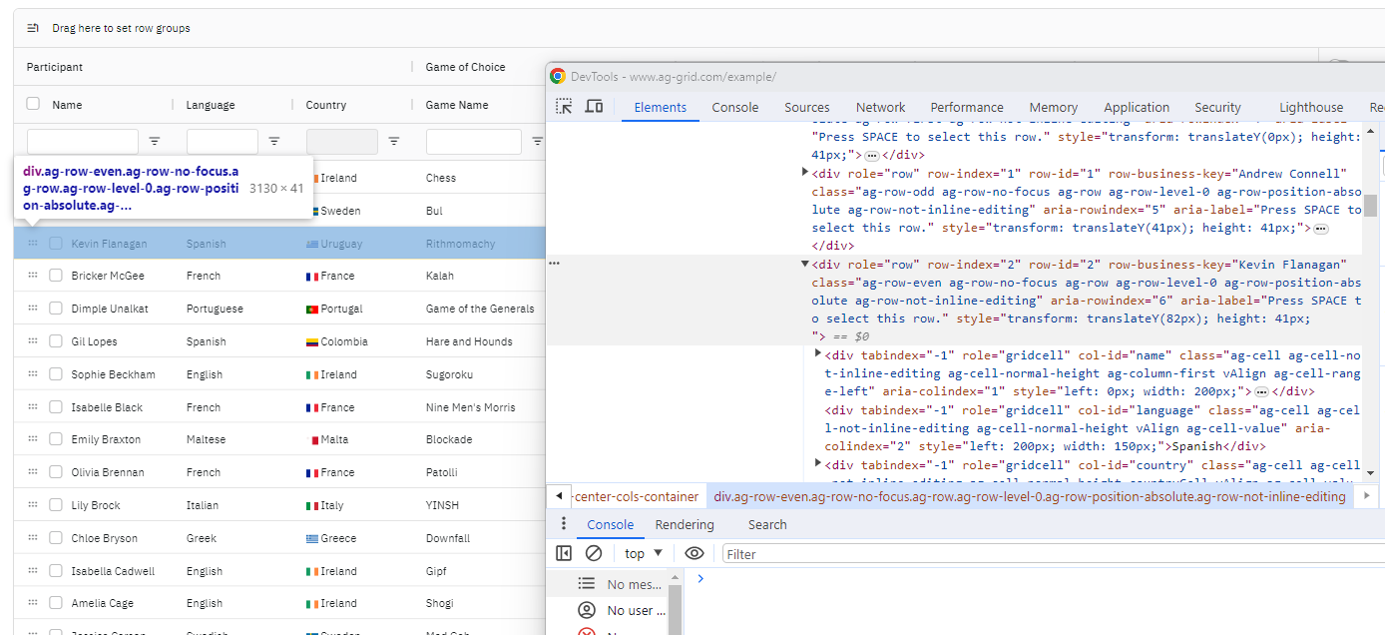
Virtual Scroll <div "style="transform: translateY(82px); ">

Slide 16
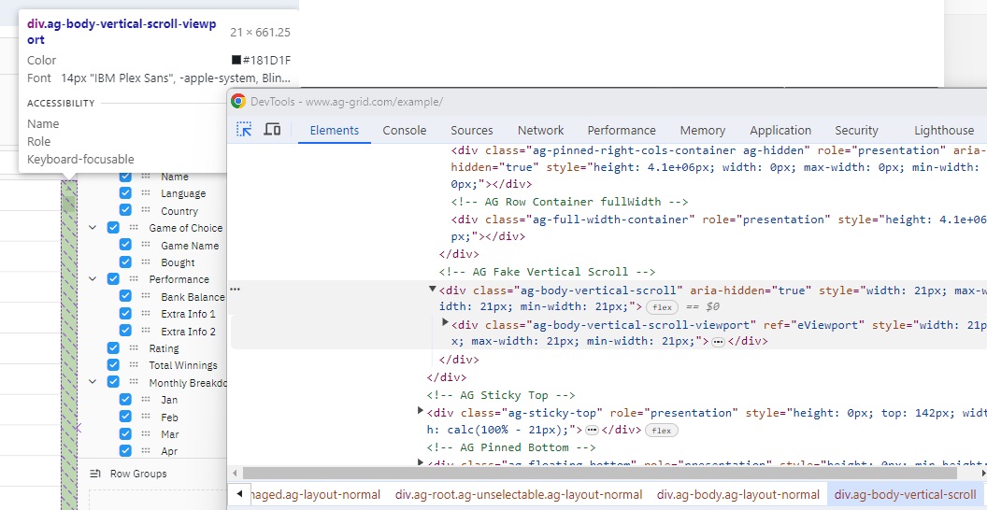
AG-grid virtual-scroll

Slide 17
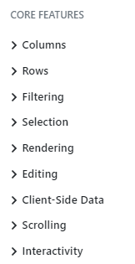
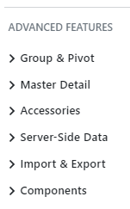
AG-Grid Features

Slide 18
Demo Example : Sorting, Export to Excel

Slide 19
Outline
Some Advanced features
AG-Grid
HighCharts
Generating (Angular) Client from Swagger
Code Scafolding
Security: Cookie, Login, OAuth2, JWT, ...
RxJs, Auto completion, ng-prime
Final Words

Slide 20
HighCharts https://www.highcharts.com

Slide 21
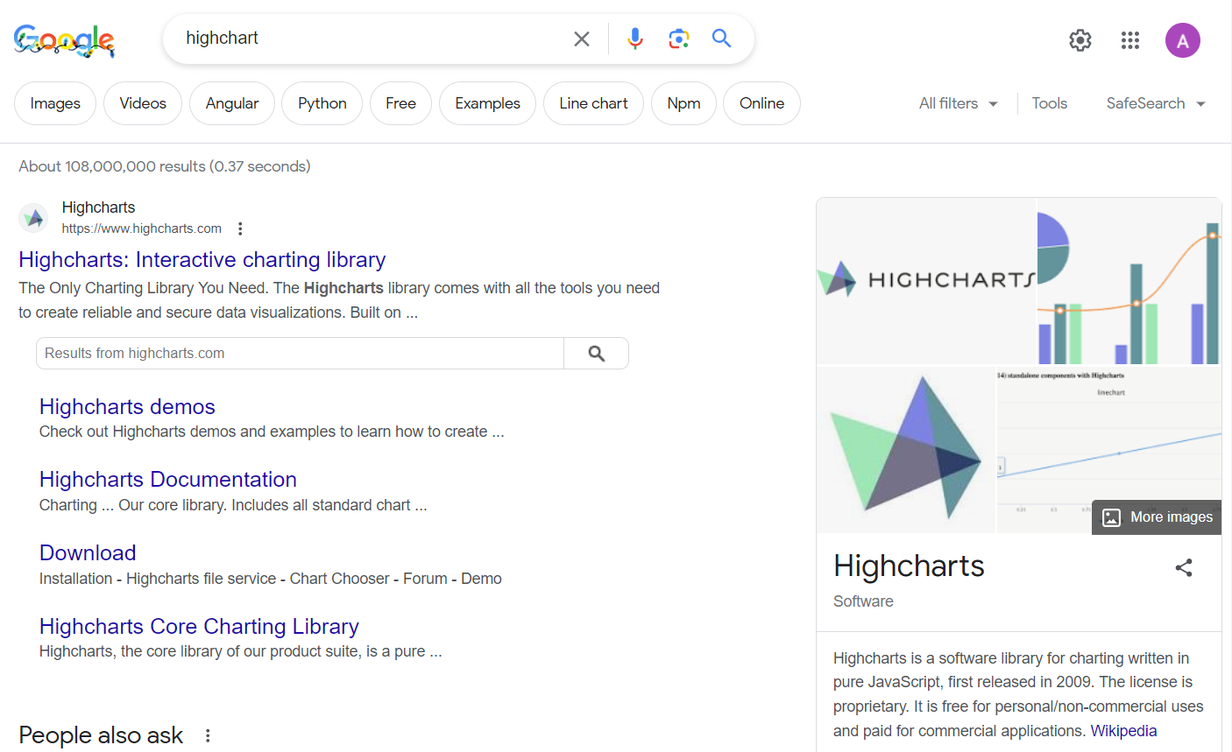
google HighCharts

Slide 22
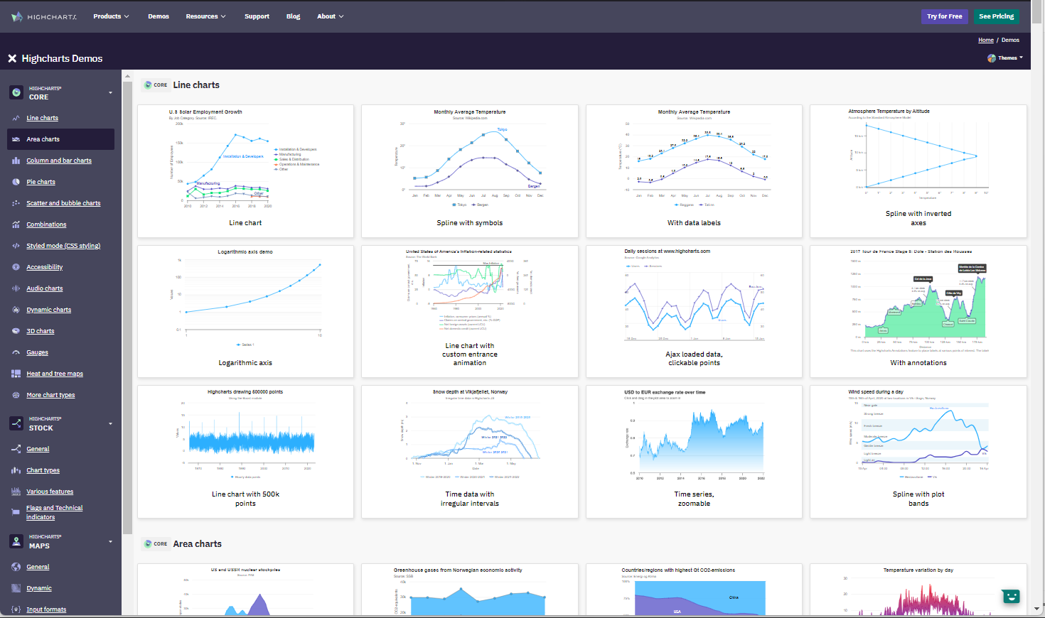
https://www.highcharts.com/demo

Slide 23
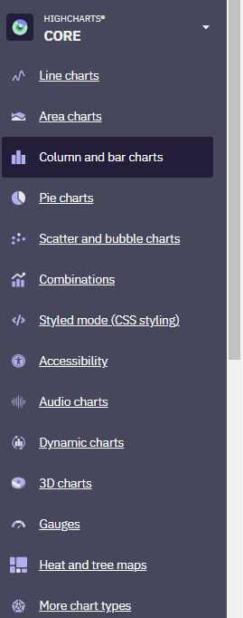
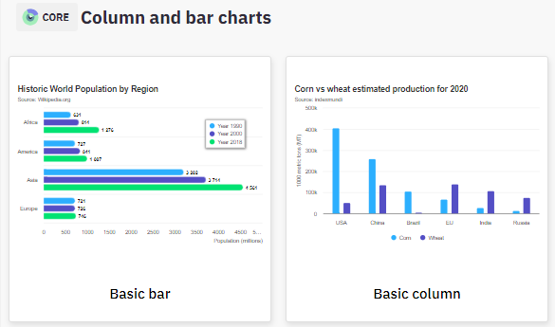
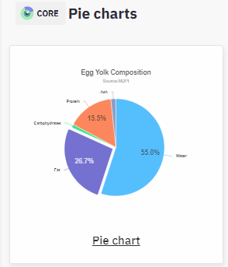
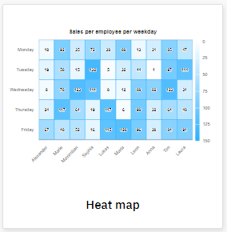
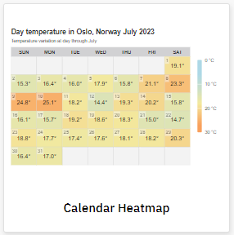
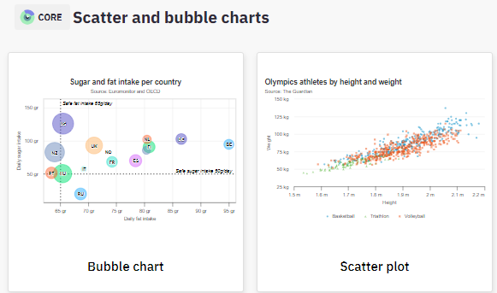
HighChart Features

Slide 24
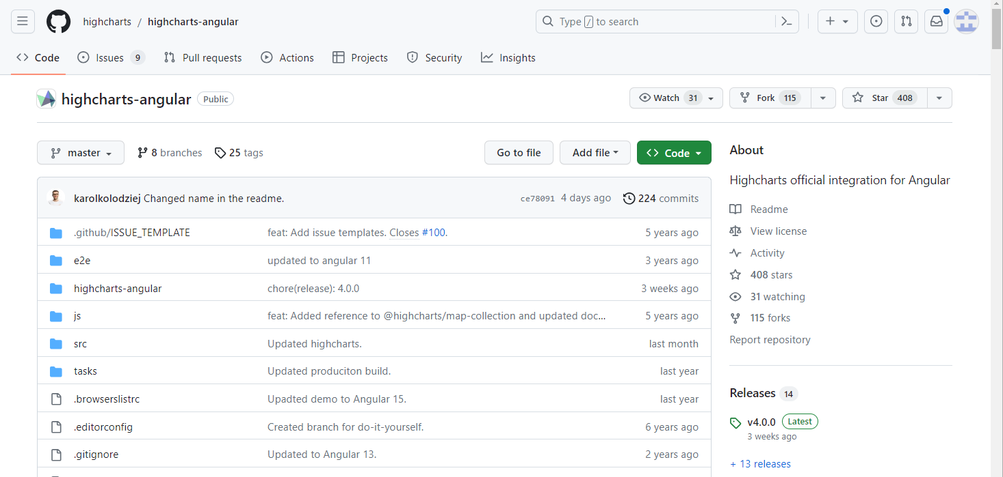
https://github.com/highcharts/highcharts-angular

Slide 25
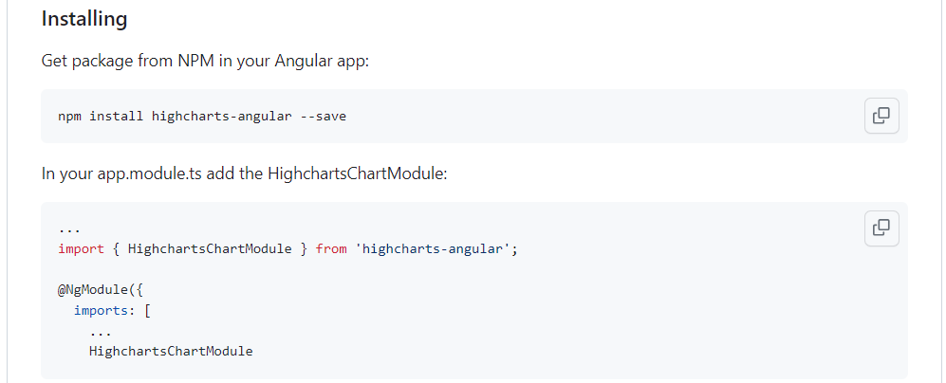
Getting Started npm install -s highcharts-angular

Slide 26
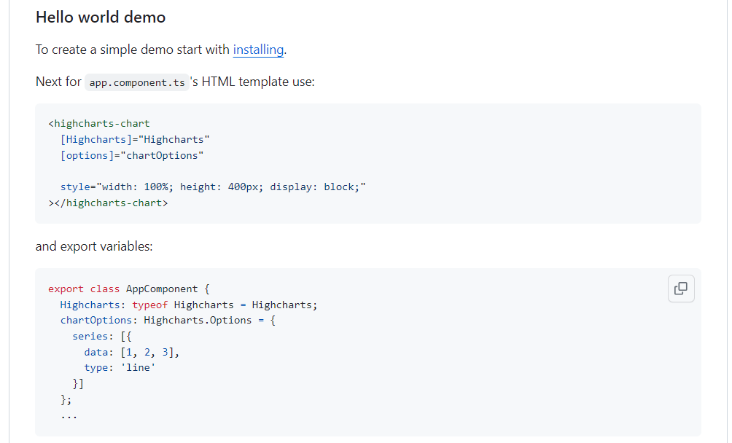
https://github.com/highcharts/highcharts-angular#hello-world-demo

Slide 27
Notice: Alternatives To HighCharts
HTML <SVG>
builtin features, but too low-level to use yourself
HTML canvas
d3js also low-level and very complex
(redundant with Angular *ngFor="let .. of ... ")
chart.js
& MANY others libraries

Slide 28
Outline
Some Advanced features
AG-Grid
HighCharts
Generating (Angular) Client from Swagger
Code Scafolding
Security: Cookie, Login, OAuth2, JWT, ...
RxJs, Auto completion, ng-prime
Final Words

Slide 29




Sharing (Partially) Codes / Same Technology for Backend and Frontend ?
Node
(reuse V8 !)
Chrome V8
JavaScript Engine
Edge
(reuse V8 !)
Chrome WebBrower
your-javascript-file-1.js
your-javascript-file-2.js

Slide 30
Different Code ANYWAY !! because Http Client != Http Server submit a Request ! = process a Request
DTO classes can be fully shared
All Node-Express route methods must be translated to HttpClient

Slide 31
Backend != FrontEnd
Long running Application Servers
run on Linux
in a DataCenter (OnPremise, AWS, Azure, ..)
Most Probably in Java
Because ... !!
Short interactive browsing
run on your Windows Laptops
or Android/iPhone SmartPhones
On Chrome / FireFox / Edge /
in JavaScript
(because you have NO choice) !!

Slide 32
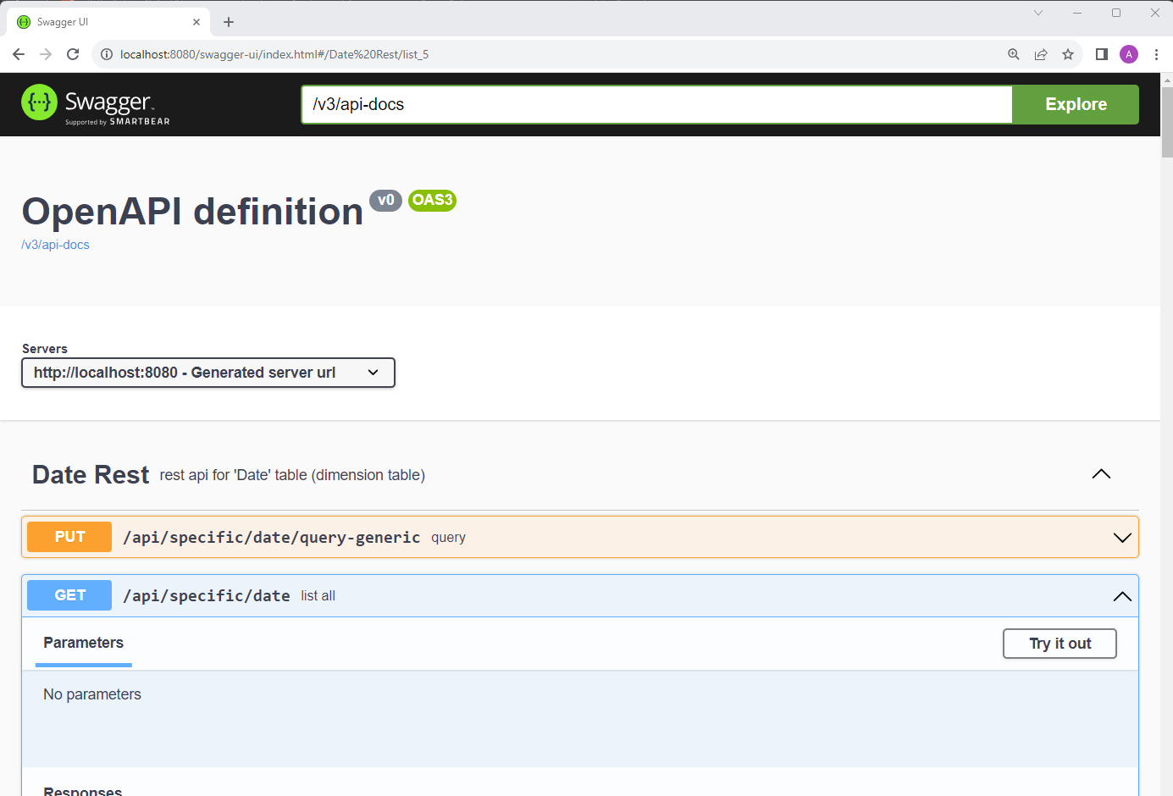
Reminder OpenApi - swagger-ui.html

Slide 33
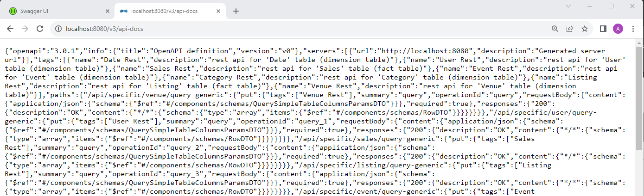
Open Api description in json : /v3/api-docs
NOT to be read by Humans !!!!
either
=> in swagger-ui.html
OR => for Client Code Generators

Slide 34
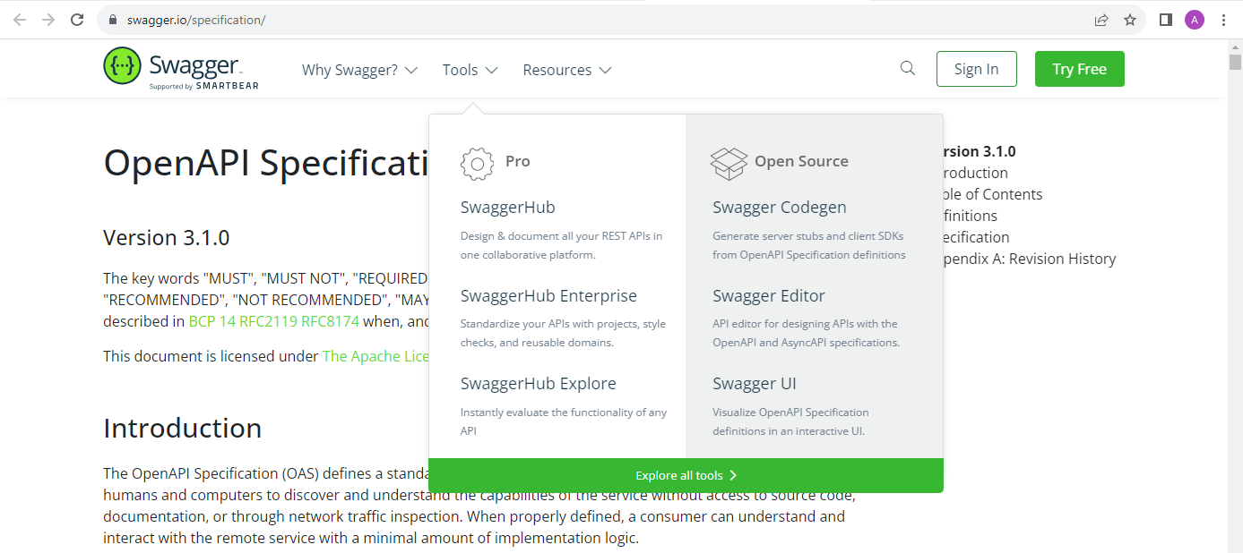
https://swagger.io Swagger Codegen

Slide 35
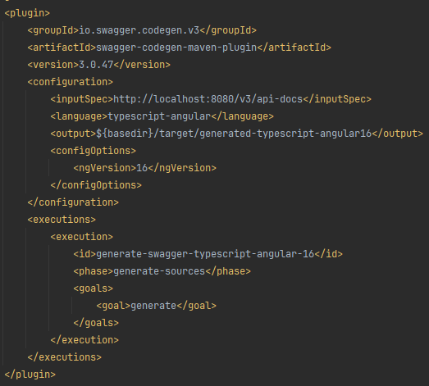
Swagger CodeGen demo (maven plugin)

Slide 36
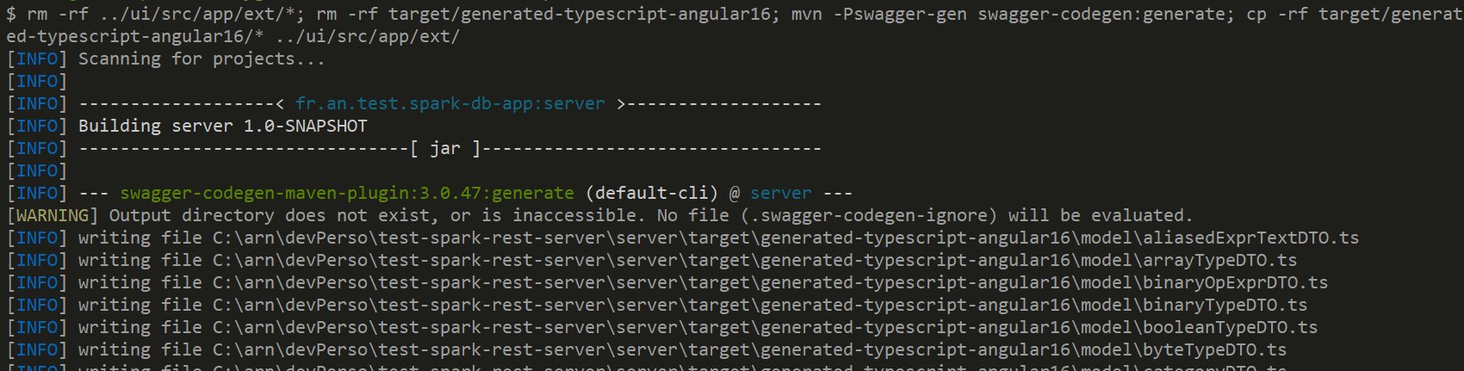
Swagger CodeGen Demo
$ mvn swagger-codegen:generate

Slide 37
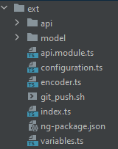
Generated code for Angular-Typescript
contains all Services for http endpoints
( = for @RestController in backend ) each PUT/POST/GET/DELETE => correspond to a typescript method
contains all interfaces describing datatypes ( = for class *DTO in backend )
each JSON request body / response type => correspond to a typescript interface

Slide 38
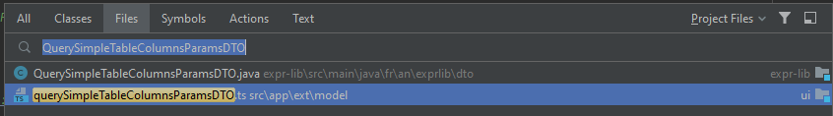
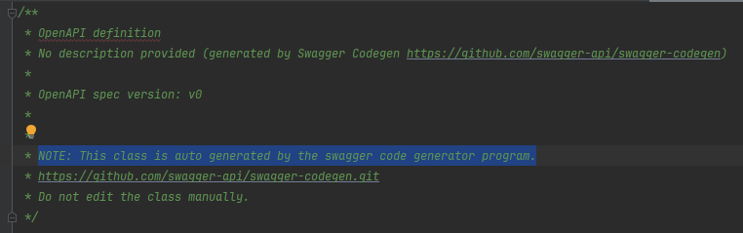
The front-end code is ALWAYS IN-SYNC with backend code!

Slide 39
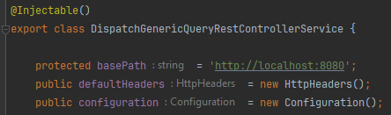
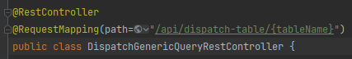
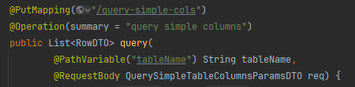
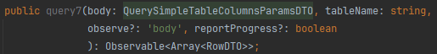
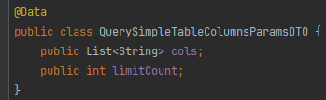
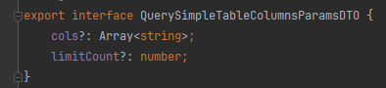
Example CodeGen
in Java (SpringBoot) backend
Generated TypeScript for Angular
Rest Controller class
http PUT method endpoint
(cf next slide for detail implementation)
DTO type for request body

Slide 40
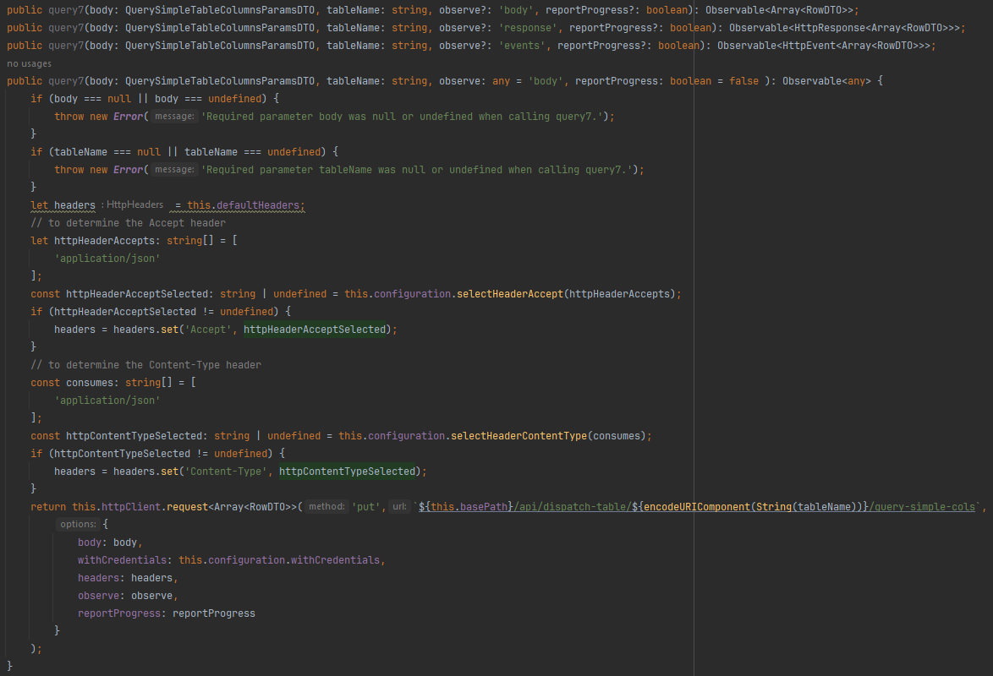
(glory details : Typescript HttpClient generated code )

Slide 41
Outline
Some Advanced features
AG-Grid
HighCharts
Generating (Angular) Client from Swagger
Code Scafolding
Security: Cookie, Login, OAuth2, JWT, ...
RxJs, Auto completion, ng-prime
Final Words

Slide 42
Code Scafolding
$ ng new
$ ng g c
= $ ng generate component
Your first scafolding tools !
a.k.a Code Generator

Slide 43
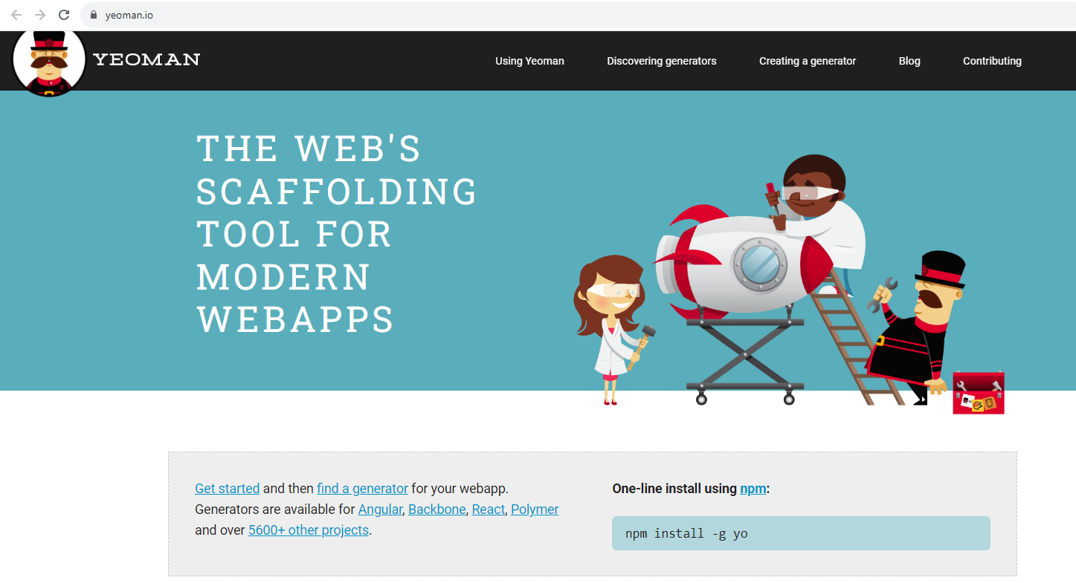
More Scafolding.. Yeoman https://yeoman.io

Slide 44

More Scafolding ... JHipster https://jhipster.tech

Slide 45
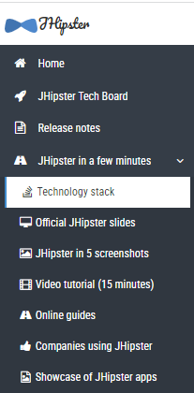
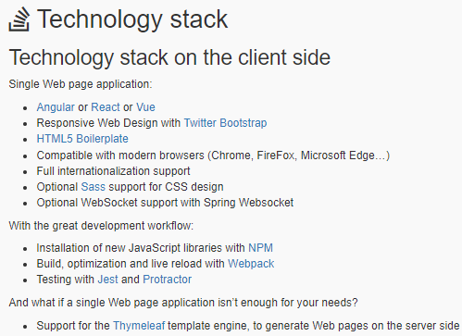
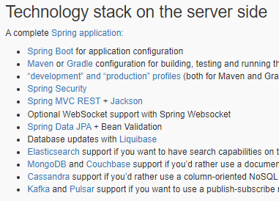
JHipster in Few minutes > Technology Stack

Slide 46

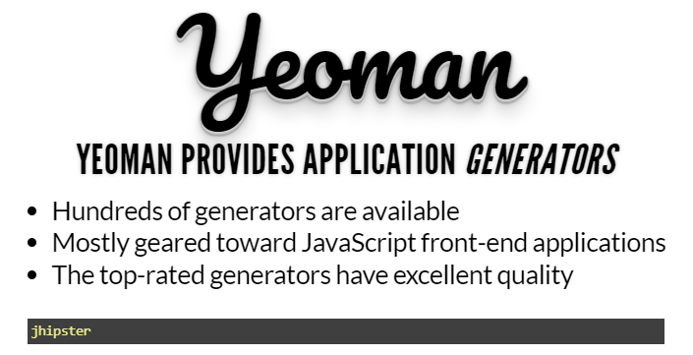

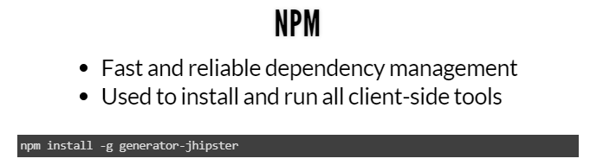
JHipster Slides - Front End Technologies
https://www.jhipster.tech/presentation/#/

Slide 47
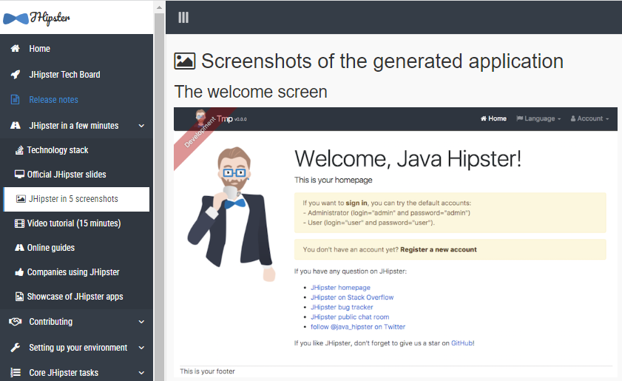
JHispter in 5 Screenshots: 1/5

Slide 48
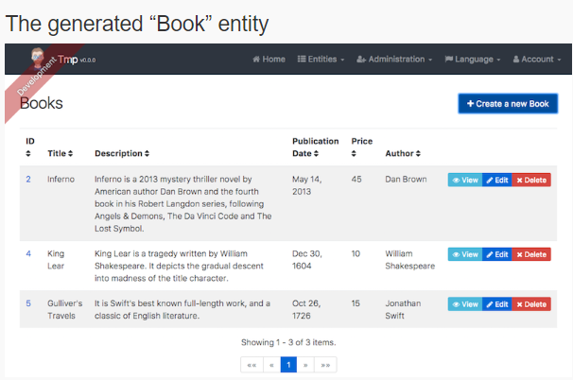
JHispter in 5 Screenshots: 2/5

Slide 49
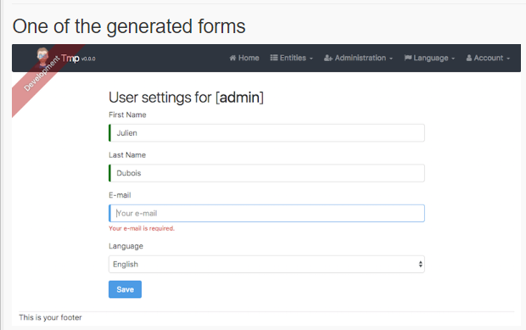
JHispter in 5 Screenshots: 3/5

Slide 50
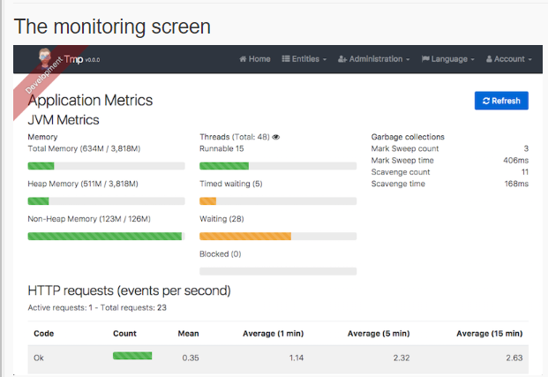
JHispter in 5 Screenshots: 4/5

Slide 51
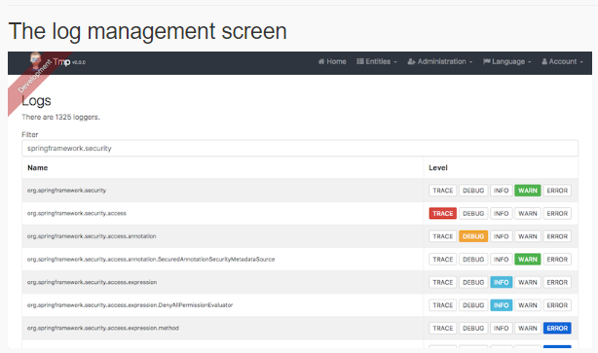
JHispter in 5 Screenshots: 5/5

Slide 52
JHipster Demo (case 1/ with local installation)
$ npm install -g generator-jhipster
$ jhipster
.... prompt....
$ jhipster add ...
$ jhipster jdl <<your-file>>.jdl

Slide 53
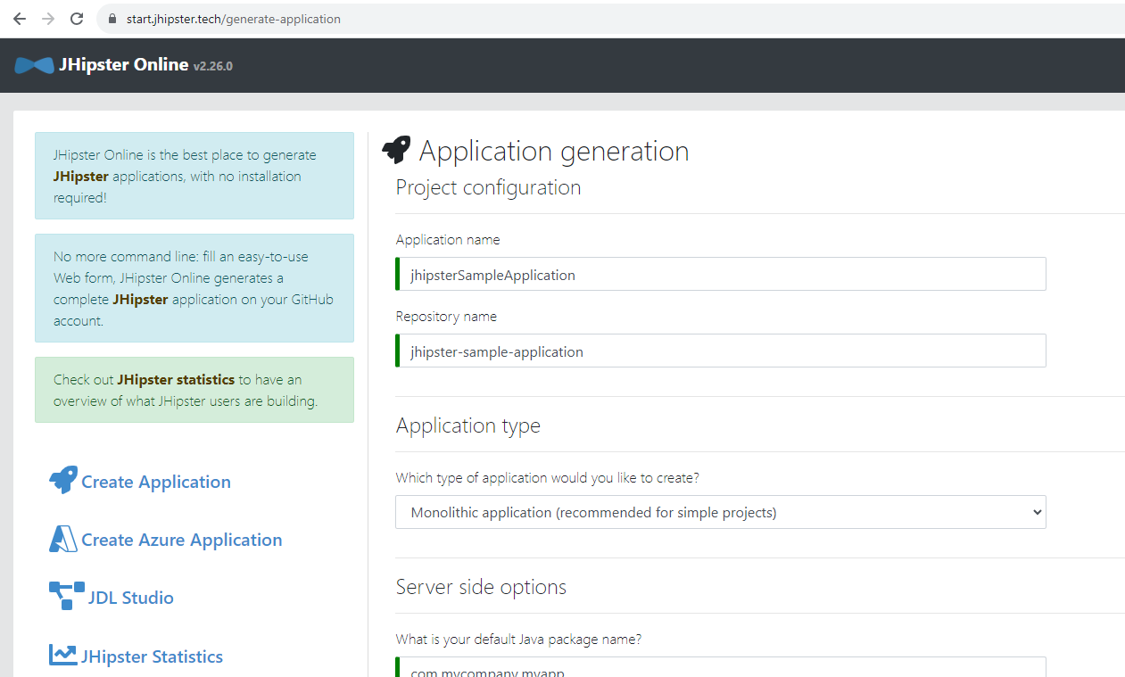

case 2 / with JHipster Online https://start.jhipster.tech/generate-application

Slide 54
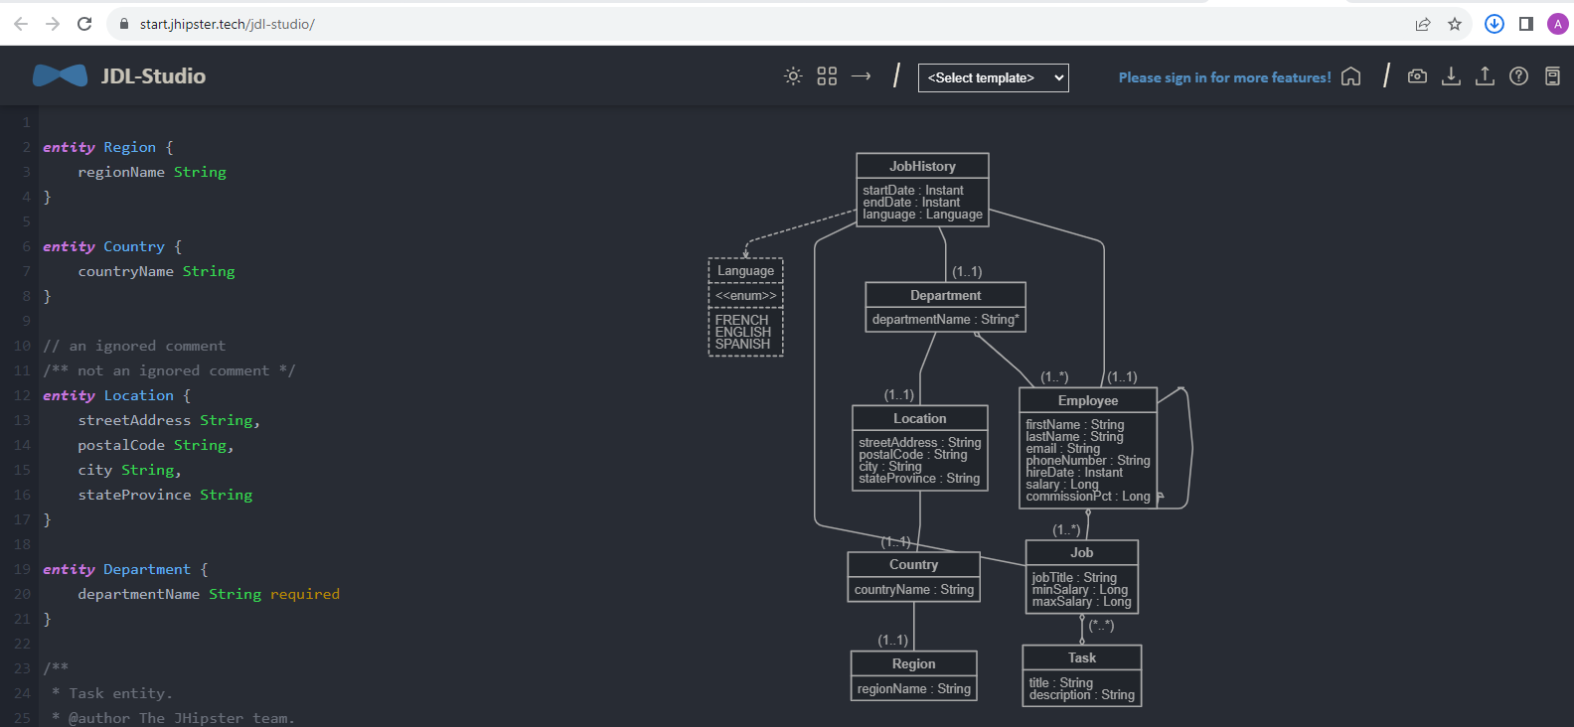
https://start.jhipster.tech/jdl-studio

Slide 55


Step 1/ Compile backend $ mvn package

Slide 56


Step 2/ Run backend $ mvn spring-boot:run -Pdev

Slide 57

Step 3/ Test Backend http://localhost:8080/management/health

Slide 58

Step 4/ compile FrontEnd $ npm install $ npm start

Slide 59


Step 5/ Start the FrontEnd $ npm start

Slide 60

Step 6/ open Browser http://localhost:4200

Slide 61

Step 7/ login as "admin/admin" or "user/user"

Slide 62


Step 8/ import jdl ... recompile & restart $ jhipster jdl ${jdlFile}

Slide 63



Step 9/ navigate Entities Table - View - EditForm

Slide 64
Outline
Some Advanced features
AG-Grid
HighCharts
Code Scafolding
Generating (Angular) Client from Swagger
Security: Cookie, Login, OAuth2, JWT, ...
RxJs, Auto completion, ng-prime
Final Words

Slide 65
Security ... should not be done half way Leave it to Experts

Slide 66
Security Basics
Encryption
Authentication
Authorization
Confidentiality
No Man-In-The-Middle
Delegated
Authentication
Authenticated
Session
httpS://
certificate Trust
relation in code
Resource
-> Permission
-> Group -> Users
user
password
OAuth2 flows
JWT token
(Cookie)

Slide 67
Http Headers "Authorization=Basic <user:pass>" "Authorization=Bearer <token>"
$ curl -v -u user:pass http://localhost:8080
password in Base64 (~clear text) on Http Header

Slide 68


Demo "Basic <Base64(user:password)>"

Slide 69

Demo: Un-authenticated

Slide 70

Demo ... 401 ( no password, bad password, bad user, or unauthorized )

Slide 71
Demo of Login in Jhipster ( if time ok ? )

Slide 72
Outline
Some Advanced features
AG-Grid
HighCharts
Code Scafolding
Generating (Angular) Client from Swagger
Security: Cookie, Login, OAuth2, JWT, ...
RxJs, Auto completion, ng-prime
Final Words

Slide 73

RxJs : Asynchronous programming with Observable & Subscribe, is Complex Powerful

Slide 74

Example RxJs Operator: map()

Slide 75
Sample usage: "unchecked JSON" DTO interface -map-> type-safe "Model" class

Slide 76




Some Object-Oriented Reasons to re-define class on client-side for DTO interface

Slide 77

Calling RxJs: .pipe(map(x => tranform(x)))

Slide 78

Other Example RxJs operator: debounceTime(millis)

Slide 79
example debounceTime() ? Doing Auto-completion -> trigger http Call(s) but NOT for each char typed
yourAngularField$ : Observable<string> = ....
yourAngularField$ .pipe(debounce(300))
// ... more rxjs operators needed (cf next slide)
.subscribe(x => { // handle field change, example for auto-completion });

Slide 80

... cf Also .distinctUntilChanged() and switchMap() !!
https://stackblitz.com/edit/ autocomplete-suggestions-seach-with-debouncing ?file=src%2Fapp%2Fapp.component.ts

Slide 81
Outline
Some Advanced features
AG-Grid
HighCharts
Code Scafolding
Generating (Angular) Client from Swagger
Security: Cookie, Login, OAuth2, JWT, ...
RxJs, Auto completion, ng-prime
Final Words

Slide 82
NG-Prime
Doing Rich web components is Difficult (and not funny)
Leave it to Experts !!
Re-use code, do not re-invent the Wheel

Slide 83

https://primeng.org

Slide 84


https://github.com/primefaces/primeng

Slide 85
(alternatives to) Prime-NG
ng-bootstrap components (but very low level, not so rich behaviors)
tons of npm libraries ... but you have a patchwork of CSS styles
Google Material Design WebComponent library
your own company already has some super cool toolkit ?

Slide 86
Outline
Some Advanced features
AG-Grid
HighCharts
Code Scafolding
Generating (Angular) Client from Swagger
Security: Cookie, Login, OAuth2, JWT, ...
RxJs, Auto completion, ng-prime
Final Words

Slide 87

Final Words
Thank you Tim

Slide 88

Render to Cesar what belongs to Cesar

Slide 89

Web Fundamental

Slide 90
JavaScript MindMap
but Used Everywhere on the Web
optimized Browsers
(native features: GPU, etc..)
Huge NPM packages ecosystem
an Infamous, Untyped, Strange Langage
interface with html
"DOM" Apis
JavaScript
optimized
native
async IOs
TypeScript as a super-set langage
interface
with NodeJS
functional langage
well interfaced with JSON
Chrome "V8"
runtime engine
backend libs
ex: Express
optimize js ?
Debugger
in DevTools & IDE
WASM (web assembly native compiler)

Slide 91



TypeScript - JavaScript Schizofrenia Troller

Slide 92





Backend - Frontend Schizofrenia Troller
Back-end Developper
Front-end Developper
Full-Stack Developper

Slide 93

Web Frameworks ... 1999 to 2020

Slide 94

Web Frameworks - 2023 and Future ?

Slide 95
Conclusion
Frameworks change every year
The Web will live long : Html + Javascript + Css

Slide 96
Questions
arnaud.nauwynck@gmail.com

